Slide 1

The National University of Computer and Emerging Sciences
Switch and Ternary Operators
CS 1002 Programming Fundamentals
Dr. Akhtar Jamil
Department of Computer Science

Slide 2
Goals
Selection Structure
Switch Statement

Slide 3
Today’s Lecture

Slide 4
switch statement
Provides a series of alternatives (selections) based on the value of a SINGLE variable
Replaces a series of chained if-else statements
Makes code easier to read

Slide 5
Switch - Syntax
switch (Variable)
{
case <value_1> : statement1;
statement2;
statement3;
break;
case <value_2> : statement1;
statement2;
break;
case <value_3> : statement1;
break;
default: statement1;
statement2;
}
Optional

Slide 6
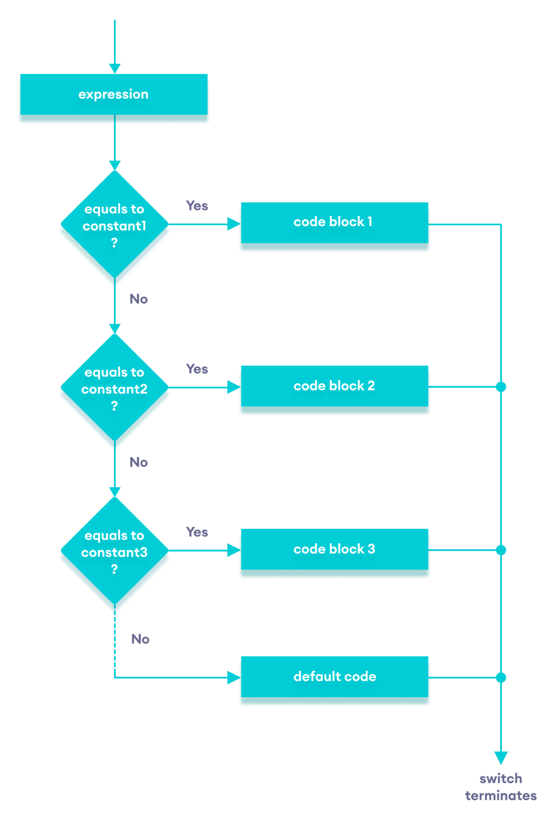

Slide 7
switch statement (without break)
Suppose ch is 'a’
switch (ch) {
case 'a': cout <<“ ch contains a”;
case 'b': cout <<“ ch contains b”;
case 'c': cout <<“ ch contains c”;
}

Slide 8
switch statement (with break)
Suppose ch is ‘b’
switch (ch) {
case 'a': cout <<“ ch contains a”; break;
case 'b': cout <<“ ch contains b”; break;
case 'c': cout <<“ ch contains c”; break;
}
cout<<“\n End of program…”;

Slide 9
Switch – Example-1
char grade;
cin>>grade;
switch (grade)
{
case ‘A’: tution_fees *= 0.20; break;
case ‘B’: tution_fees *= 0.40; break;
case ‘C’: tution_fees *= 0.60; break;
default: tution_fees *= 1;
}

Slide 10
Switch – Example-2
int day;
cout<<“Enter day number“; cin>>day;
switch (day) {
case 1 :
case 7 : cout << "This is a weekend day";
break;
case 2 :
case 3 :
case 4 :
case 5 :
case 6 : cout << "This is a weekday"; break;
default : cout << "Not a legal day";
}

Slide 11
Switch – Example-3
int a, b; char key;
cout<<“\nEnter numbers: “;
cin>>a>>b;
cout<<“Enter an arithmetic operator”;
cin>> key;
switch (key)
{
case ‘+’ : cout<<(a+b); break;
case ‘-’ : cout<<(a-b); break;
case ‘*’ : cout<<(a*b); break;
case ‘/’ : cout<<(a/b); break;
default: cout<<“Error: Invalid key…";
}

Slide 12
Nested Switch
switch can also be nested…
Another switch part of the case component
Example…

Slide 13
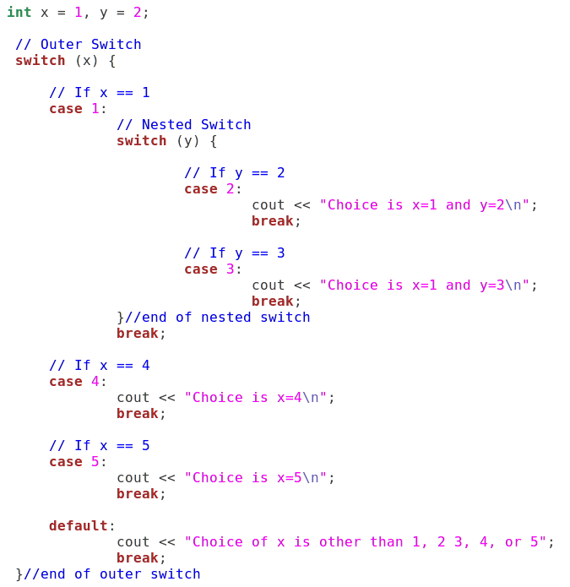
Example: Nested switch

Slide 14
Ternary/Conditional Operator
The conditional operator ( ? : ) is a ternary operator (three operands), is used to simplify an if/else statement.
expression1 ? expression2 : expression3;
If expression1 is true, the result of the conditional expression is expression2. Otherwise, the result is expression3

Slide 15
Conditional Operator (Ternary operator)
if (x > 0)
y = 1;
else
y = -1;
is equivalent to
y = (x > 0) ? 1 : -1;
Syntax:
result = (condition) ? Expression1 : Expression2;

Slide 16
Conditional Operator, examples
cout << ((num % 2 == 0) ? "num is even" : "num is odd");
int min_value = (num1<num2) ? num1 : num2;
unsigned int absvalue = (n< 0) ? -n : n;

Slide 17
Nested Ternary Operator
Just like if…, ternary operator can be nested too
Syntax:
result = (condition) ? Expression1 : Expression2;
This can be another test condition …

Slide 18
Examples…
a ? b : c;
➔
if ( a )
b;
else
c;

Slide 19
Examples…
//conditions are in red
a ? b : c ? d : e ? f : g ? h : i;
➔
if (a)
b;
else if (c)
d;
else if (e)
f;
else if (g)
h;
else
i;

Slide 20
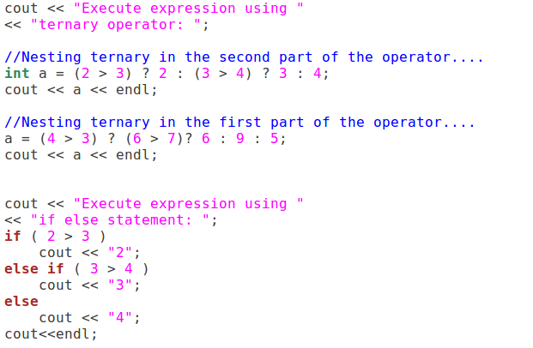
Nesting can be in any part of the operator

Slide 21
Exercise-1
What will be the output of the following code?
int marks= 2;
switch(marks)
{
case 1: cout<<”You are in year-1”;
case 2: cout<<”You are in year-1”;
case 3: cout<<”You are in year-2”;
case 4: cout<<”You are in year-2”;
}

Slide 22
Exercise-2
What will be the output of the following code?
int n = -29;
int temp = (n<0)?-n:n;
cout<<temp;

Slide 23
Exercise-3
What will be the output of the following code?
int x=21, y=31, z=44;
if(x>16 && y>x || z%2==0 )
cout<<“Hello“;
else
cout<<“World!“;

Slide 24
Exercise-4
What will be the output of the following code?
int a = 5, b = 30;
if(a > b)
if(b > 0)
a = a + 5;
else
if(b >= 30)
b = b * 10;
cout<<”a=”<<a<<” ”<<”, b=”<<b;

Slide 25
Exercise-5
What will be the output of the following code?
int x = 5, y = 30;
if(y/x > 2)
if(y % x !=2)
x = x + 2;
cout<<x<<”\n“<<y;

Slide 26
Exercise-6
Write a program that ask the user to enter a number in the range of 1—10.
Use a switch statement and display corresponding Roman Number against each entered decimal value. E.g.,
1 → I
2 → II
3 → III
4 → IV

Slide 27
Exercise-7
Write a program that ask to input value in seconds. Then the program converts the number of seconds into days, hours, minutes, and seconds value. In the end, the program shows the output in the following format:
Days:2 Hours:13 Minuts:32 Seconds:11

Slide 28
Exercise-8
Write a program that calculate the person’s Body Mass Index (BMI). The BMI is often used to determine if a person is overweight, underweight for his/her height.
BMI is calculated as:
BMI = (weight * 703) / (height*height)
Here weight is in pounds and height is in inches.
The program should display the message:
- “Optimal Weight” if BMI is 18.5—25
- “Under Weight” if BMI is < 18.5
- “Over Weight” if BMI is > 25

Slide 29
Reading Task
Implement all the tasks given in this lecture

Slide 30
References
Credit goes to Dr. Muhammad Aleem for preparation of slides
Text book: Starting out with c++

Slide 31
Thank You ☺

